Slide 1
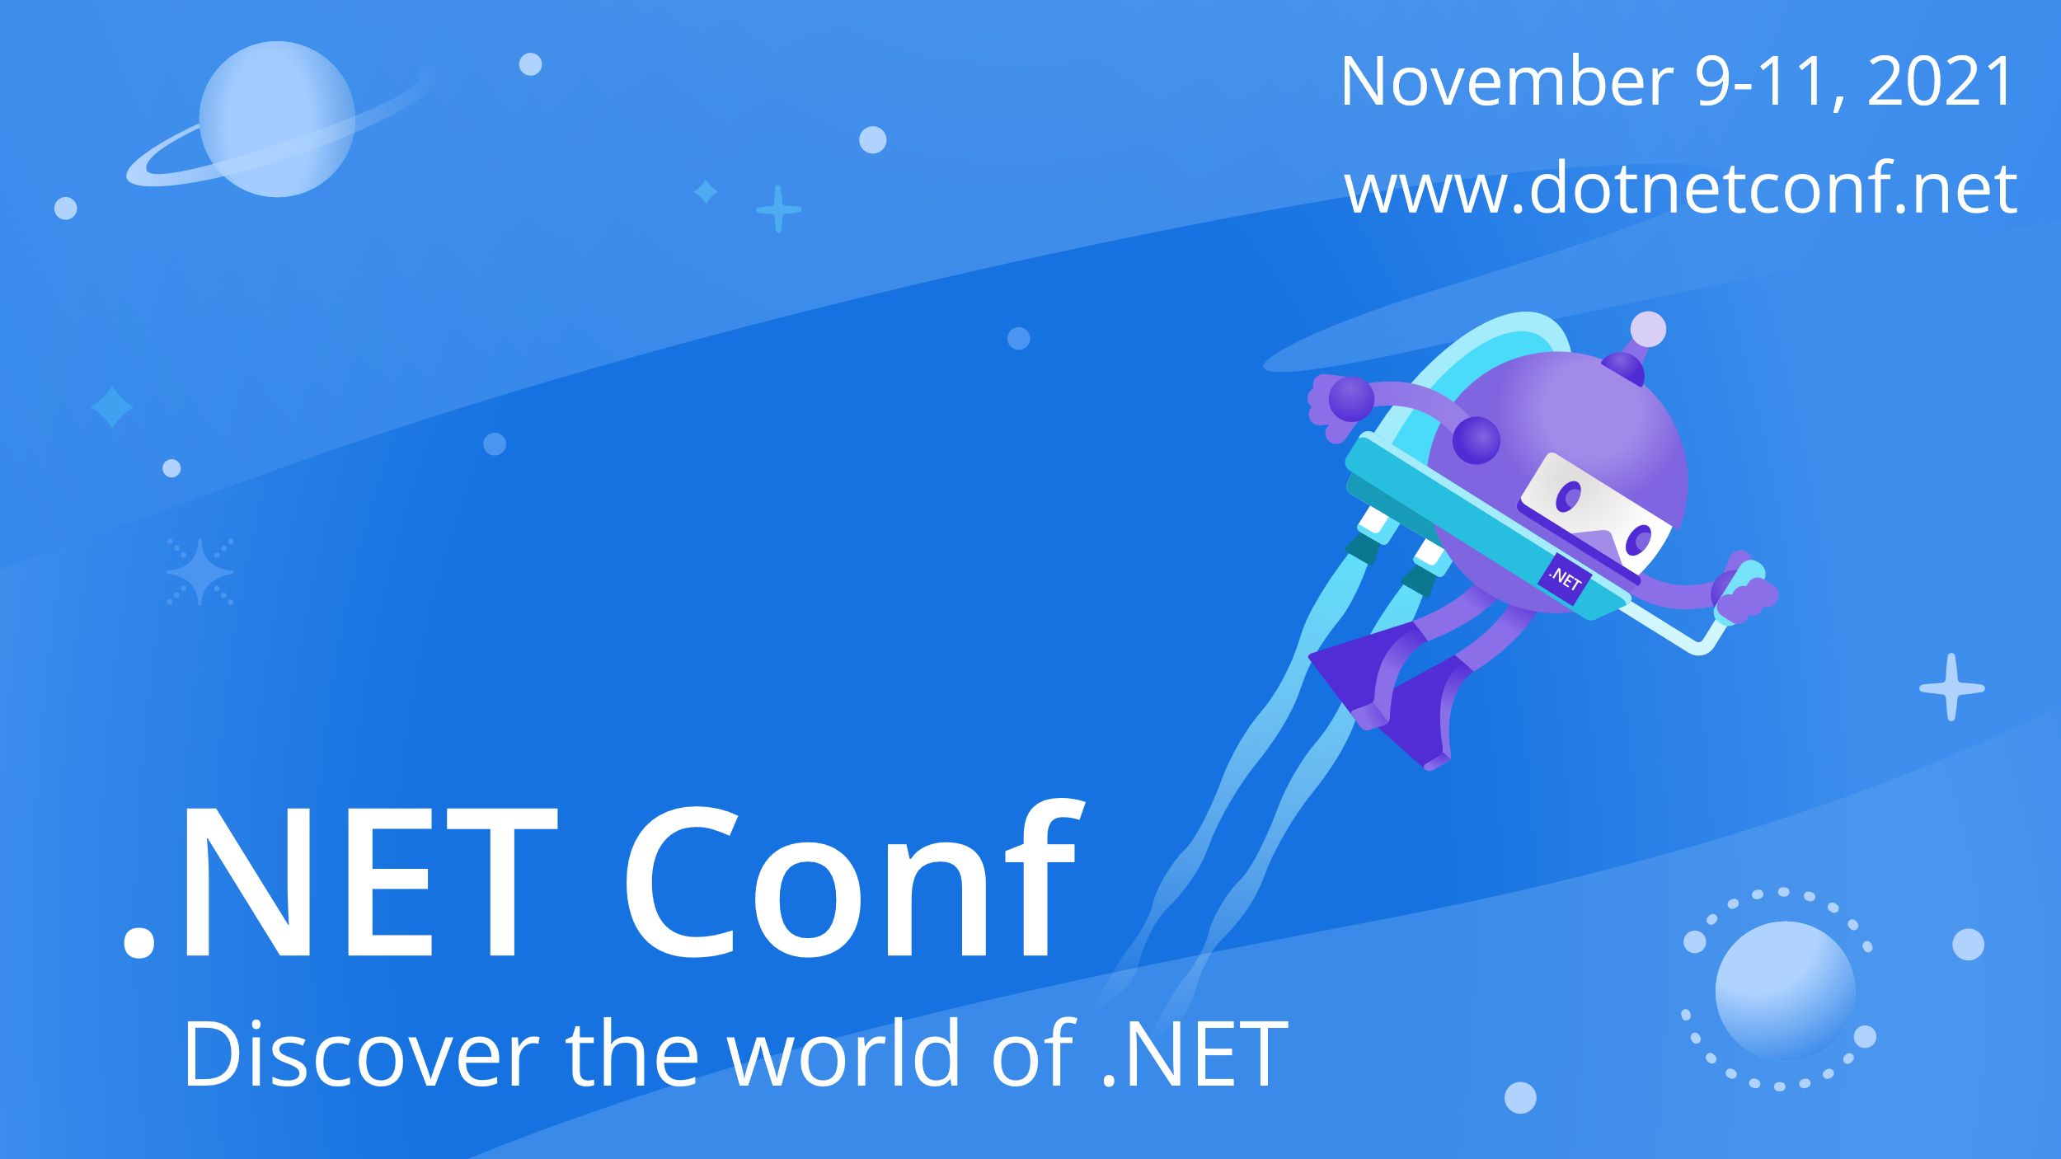

Slide 2

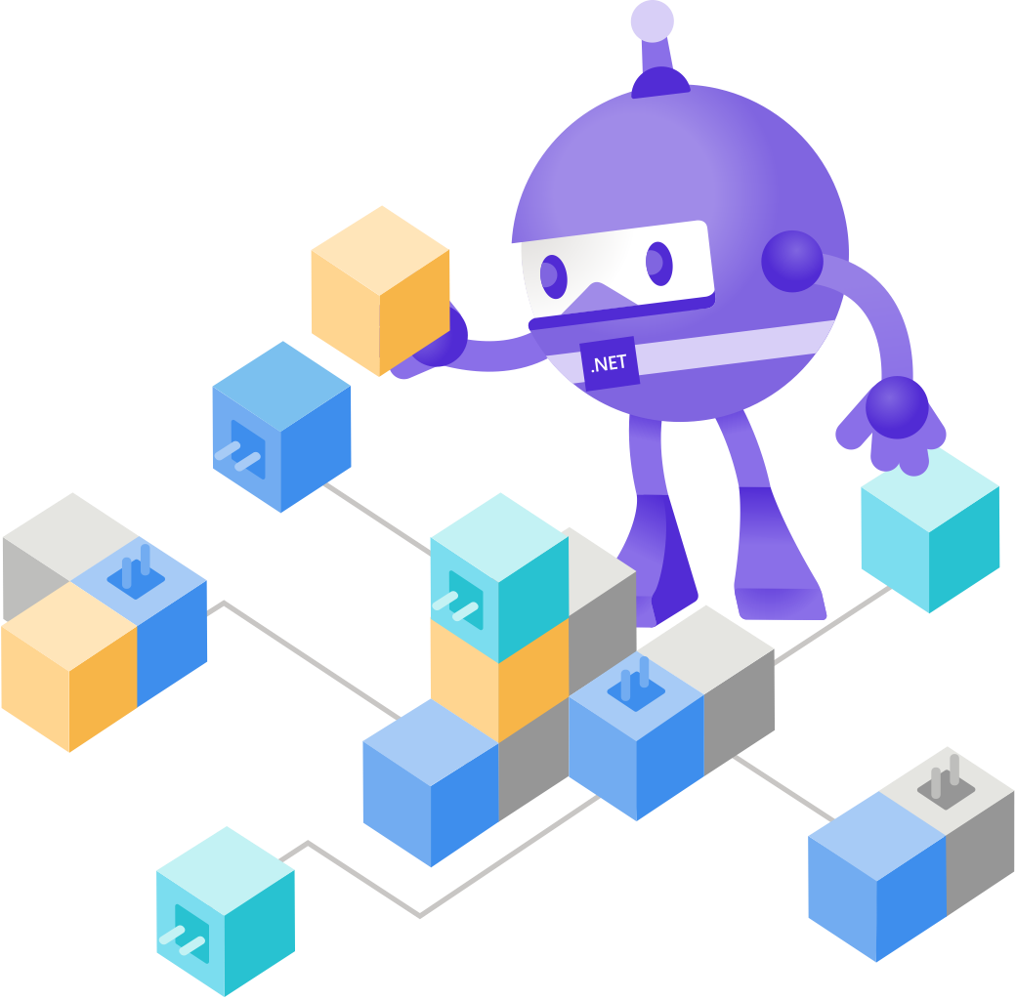
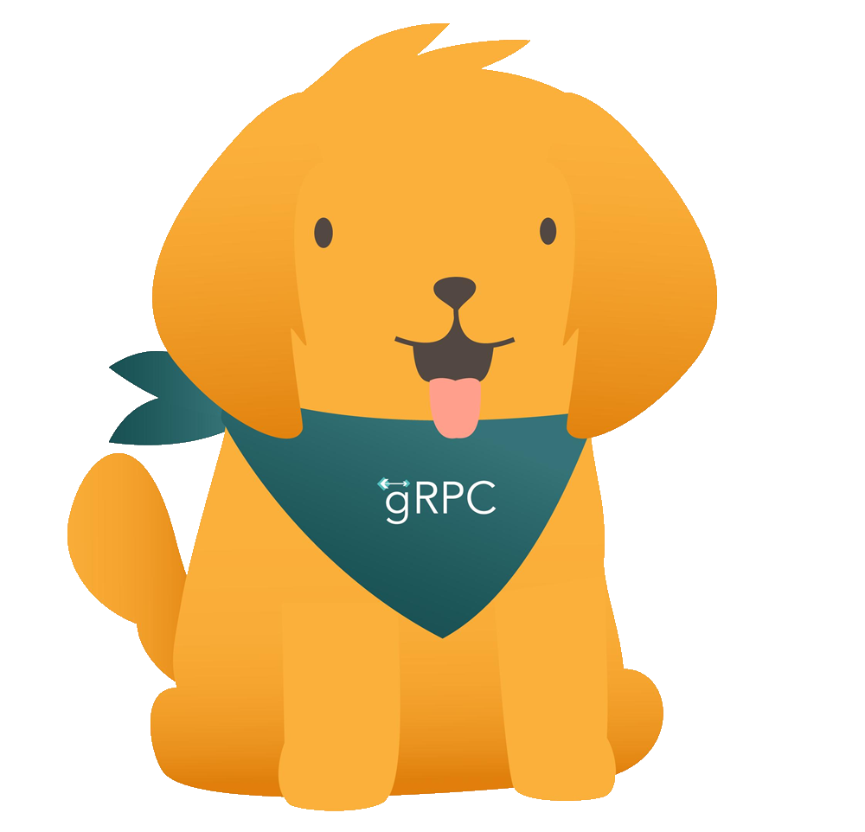
High-performance services with gRPC What’s new in .NET 6
James Newton-King
Principal Software Engineer
Microsoft

Slide 3
Agenda
What is gRPC
Demo
What’s new in .NET 6
Performance
Transient fault handling
Client-side load balancing
HTTP/3
Resources

Slide 4




gRPC is…
Popular open source RPC framework
Cross-platform
Contract first
Uses modern technology
HTTP/2
Protobuf
+
=

Slide 5




gRPC is…
Enables multiplexing, advanced streaming
High-performance. Protobuf is small and fast
HTTP/2 isn’t supported everywhere
Protobuf isn’t human readable
Request
gRPC client
Response
gRPC server
.proto
Generate client
Generate service base
.proto file + gRPC tooling
Productivity. Code generation
Contract & tooling is required

Slide 6
Demo
Build a basic gRPC app

Slide 7
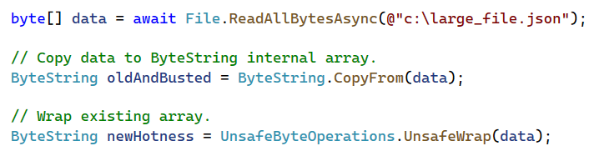
What’s new: Performance
Protobuf serialization
ASCII string serialization uses SIMD
20% faster overall improvement
Zero copy ByteString API
gRPC download speed
Transatlantic 2 MB download:
.NET 5 – 6.3 seconds
.NET 6 – 1.6 seconds
Blazor AOT with gRPC-Web
gRPC is 10 times faster with AOT

Slide 8
What’s new: Transient fault handling
Automatically retry failed gRPC calls
Configure statuses to retry and exponential backoff
Request #1
Unavailable
Request #2
gRPC client
Unavailable
gRPC server
Request #3
OK

Slide 9

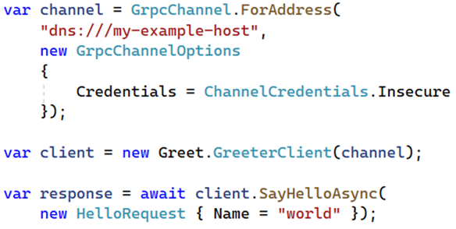
What’s new: Client-side load balancing
gRPC client supports client-side load balancing
Discover endpoints (DNS, static, custom)
Load balance (pick first, round robin, custom)
Discovery
Request #1
Server 1
127.0.0.100
gRPC client
Request #2
Server 1 – 127.0.0.100
Server 2 – 127.0.0.101
Server 1 – 127.0.0.100
Server 2 – 127.0.0.101
Server 2 – 127.0.0.102
Server 2
127.0.0.101
Server 2
127.0.0.102

Slide 10
Demo
Client-side load balancing

Slide 11
What’s new: HTTP/3
End-to-end support over HTTP/3 (preview)
HTTP/3 benefits:
Faster response time of the first request
Improved experience when there is connection packet loss
Supports transitioning between networks

Slide 12
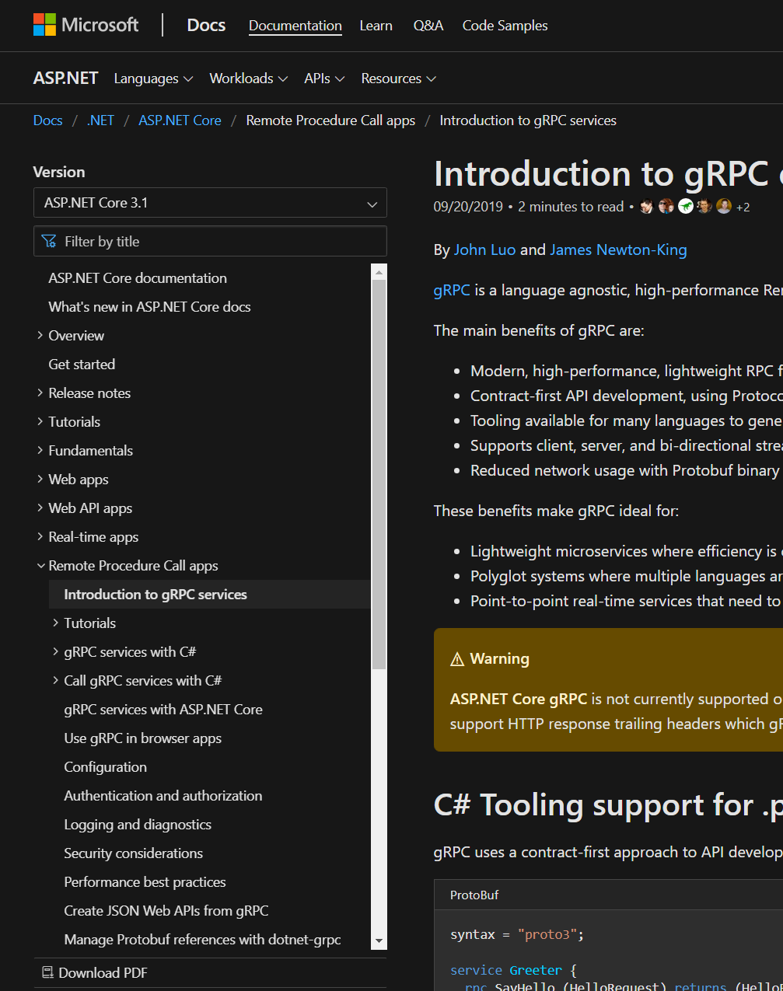
Resources – Docs
Intro tutorial
Creating gRPC services
Calling gRPC services
Create Protobuf messages
Versioning gRPC services
Use gRPC in browser apps
Create JSON Web APIs from gRPC
Performance best practices
And more
https://aka.ms/grpcdocs

Slide 13
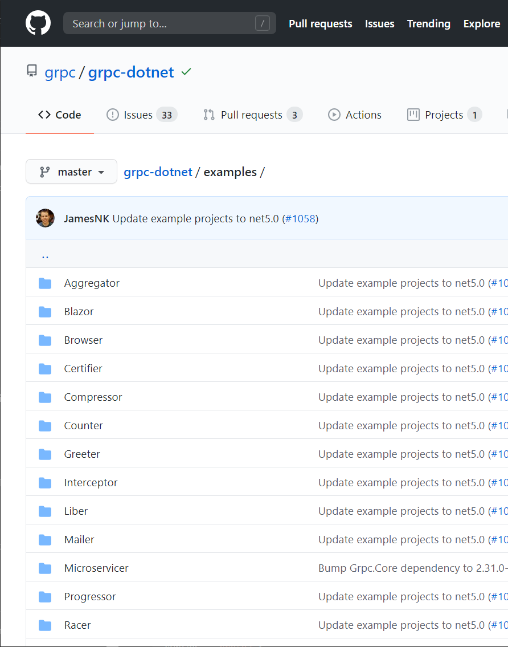
Resources – Examples
Hello world
Streaming
Certificate authentication
JWT authentication
OpenTelemetry
Unix domain sockets
Unit testing
Cancellation
And more
https://aka.ms/grpcexamples

Slide 14

Thanks for joining!

